Slide 1
File descriptor table
File descriptor (integer) | File name
0 | stdin
1 | stdout
2 | stderr
Use open(), read(), write() system calls to access files
Open() creates a file and returns fd (minimum value)
fd=open(path, O_WRONLY|O_CREAT|O_TRUNC, mode)
Think what happens in case of redirection?
ls>file

Slide 2
File descriptor table
File descriptor (integer) | File name
0 | stdin
1 | stdout
2 | stderr
Updates the FDT
Inserts the fd at the first empty entry of FDT
dup(fd)
int dup(int fd)
Notes:
<number>

Slide 3
main()
{
int fd[2];
int n=0, i;
pipe(fd);
if (fork() == 0) {
/* Child process */
close(1) ;
dup(fd[1]) ;
close(fd[0]);
for (i=0; i < 10; i++) {
printf("%d\n",n);
n++;
}
}
else {
close(0) ;
dup(fd[0]) ;
close(fd[1]);
for (i=0; i < 10; i++) {
scanf("%d",&n);
printf("n = %d\n",n);
sleep(1);
}
}
}

Slide 4
Message queue
Inter process communication primitive
Creates a permanent channel for communication
Process A
Process B
Create a message queue instance
int msgget(key_t key, int msgflg)
Flag (IPC_CREAT, IPC_EXCL, read, write permission)
Message queue identifies
Name of the message queue

Slide 5
int main()
{
int msgid,len;
key_t key;
key=131;
msgid=msgget(key,IPC_CREAT|0666);
printf("\nq=%d",msgid);
}
ipcs –q displays the message queue information in the system
Keys MsqID owner permission user bytes messages

Slide 6
Kernel view
Message headers
Queue headers
Data area
Q0
Q1
Q2

Slide 7
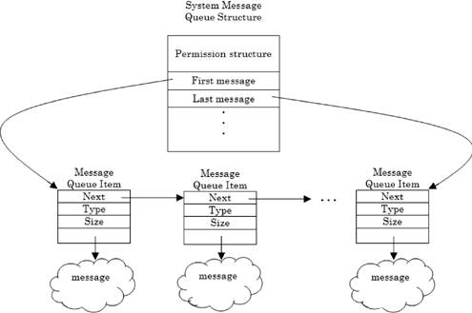
Kernel view

Slide 8
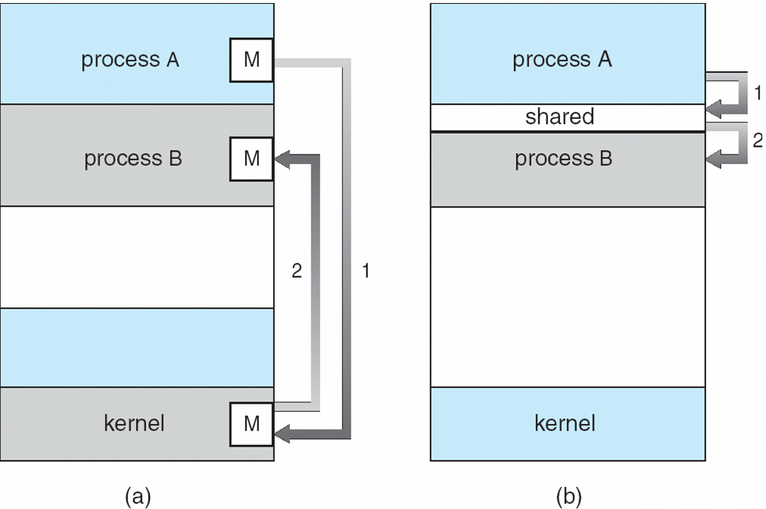
Interprocess communication
Message queue
Shared memory

Slide 9
msqid structure
/* one msqid structure for each queue on the system */
struct msqid_ds {
struct ipc_perm msg_perm;
struct msg *msg_first; /* first message on queue */
struct msg *msg_last; /* last message in queue */
time_t msg_stime; /* last msgsnd time */
time_t msg_rtime; /* last msgrcv time */
time_t msg_ctime; /* last change time */
ushort msg_cbytes; /*current number of bytes*/
ushort msg_qnum; /*current number of messages*/
ushort msg_qbytes; /* max number of bytes on queue */
ushort msg_lspid; /* pid of last msgsnd */
ushort msg_lrpid; /* last receive pid */
};
struct ipc_perm {
key_t key;
ushort uid; /* user euid and egid */
ushort gid;
ushort cuid; /* creator euid and egid */
ushort cgid;
ushort mode; /* access modes see mode flags below */
ushort seq; /* slot usage sequence number */ };

Slide 10
Message header
Struct msg
{ struct msg *msg_next
long msg_type
short msg_ts //test size
short msg_spot //map address
}

Slide 11
Message control
Display state of a msg queue
Set the parameters
Remove the msg queue
int msgctl(int msqid, int cmd, struct msqid_ds *buf)
Message queue ID
IPC_STAT: status of the queue
IPC_SET: sets parameters
IPC_RMID: removes
Displays/sets the state
ipcrm –q <id>

Slide 12
Display state
int qid;
struct msqid_ds qstat;
qid=msgget((key_t)131,IPC_CREAT);
if(qid==-1)
{
perror("msg failed\n");
exit(1);
}
if(msgctl(qid,IPC_STAT,&qstat)<0)
{
perror("msgctl failed");
exit(1);
}
printf("\n%d msg in q",qstat.msg_qnum);
printf("last msg send by process %d",qstat.msg_lspid);
printf("last msg receved by process %d",qstat.msg_lrpid);
printf("current number of bytes on queue %d",qstat.msg_cbytes);
printf("max number of bytes %d",qstat.msg_qbytes);
qstat.msg_perm.cuid
qstat.msg_perm.cuid
qstat.msg_perm.mode=>octal
qstat.msg_stime
qstat.msg_rtime
time_t=> use ctime()

Slide 13
Set state
int main()
{
int qid;
struct msqid_ds qstat;
qid=msgget((key_t)131,IPC_CREAT);
if(qid==-1)
{
perror("msg failed\n");
exit(1);
}
if(msgctl(qid,IPC_STAT,&qstat)<0)
{
perror("msgctl failed");
exit(1);
}
printf("\n%d msg in q",qstat.msg_qnum);
printf("last msg send by process %d",qstat.msg_lspid);
printf("last msg receved by process %d",qstat.msg_lrpid);
printf("current number of bytes on queue %d",qstat.msg_cbytes);
printf("max number of bytes %d",qstat.msg_qbytes);
}
qstatus.msg_qbytes=5120
qstatus.msg_perm.mode=0644
msgctl(qid,IPC_SET,&qstatus);

Slide 14
Remove
int main()
{
int qid;
struct msqid_ds qstat;
qid=msgget((key_t)131,IPC_CREAT);
if(qid==-1)
{
perror("msg failed\n");
exit(1);
}
if(msgctl(qid,IPC_STAT,&qstat)<0)
{
perror("msgctl failed");
exit(1);
}
printf("\n%d msg in q",qstat.msg_qnum);
printf("last msg send by process %d",qstat.msg_lspid);
printf("last msg receved by process %d",qstat.msg_lrpid);
printf("current number of bytes on queue %d",qstat.msg_cbytes);
printf("max number of bytes %d",qstat.msg_qbytes);
}
msgctl(qid, IPC_RMID, NULL)
Removes the message queue
ipcrm –q <id>

Slide 15
Sending message
int msgsnd(int msqid, const void *msgp, size_t msgsz, int msgflg);
Queue ID
Message content
Message size
Flag
0,
IPC_NOWAIT
Struct message
{
long mtype;
char mtext[15];
}
The msgsnd() system call appends a copy of the message pointed to by msgp to the message queue whose identifier is specified by msqid.

Slide 16
Sending message
struct message
{
long mtype;
char mtext[15];
};
int main()
{
int msgid,len;
key_t key;
struct message msg;
key=131;
msgid=msgget(key,IPC_CREAT|0666);
printf("\nq=%d",msgid);
strcpy(msg.mtext,"hello world\n"); //User memory space
msg.mtype=1; //User memory Space
len=strlen(msg.mtext);
if(msgsnd(msgid,&msg,len,0)==-1) //User to Kernel memory space
{
printf("error\n");
exit(1);
}
type

Slide 17
Receiving message
int msgrcv(int msqid, void *msgp, size_t msgsz, long msgtyp, int msgflg);
Message content
Msg size
Msg Queue ID
The msgrcv() system call removes a message from the queue specified by msqid and places it in the buffer pointed to by msgp.
Flag
MSG_NOERROR => If actual message length is greater than msgsz, receive the message with Truncation
Else, return without receiving-> error
If no message, wait
IPC_NOWAIT
IPC_EXCEPT
Type:
If x=0, first message in the queue is retrieved
x>0, first message with type x will be retrieved

Slide 18
Receiving message
struct message
{
long mtype;
char mtext[15];
};
int main()
{ int msgid,len=20;
key_t key;
struct message buff;
key=131;
msgid=msgget(key,IPC_CREAT|0666);
printf("\nq=%d",msgid);
if(msgrcv(msgid,&buff,len,0,0)==-1) //Kernel to user memory space
{
perror("msgrv failed\n");
exit(1);
}
printf("\nmsg received %s",buff.mtext); //User memory space
}

